Slide 1
Daily Review
Answer the following questions based on the table to the right:
What is the table missing?
At which speed is the braking distance 99.2 m?
What is the braking distance at 80 km/h?
What is the difference between the braking distances at 40 km /h and 120 km/h?
Braking distance at different speeds
Speed (km/h) | Braking distance
0 | 0.0
40 | 11.0
80 | 44.1
120 | 99.2
Speed (km/h) | Braking distance (m)
0 | 0.0
40 | 11.0
80 | 44.1
120 | 99.2
Reminders:
All tables need: A title Headings with units in the first row I.V. in the first column, D.V. in the second

Slide 2
Scientific Method: Drawing Column Graphs Year 7 Science

Slide 3
Learning Objective
CFU 1
What type of graph are we drawing today?
Draw column graphs of discrete data.
CFU 2
What is discrete data?
Activate Prior Knowledge
Think, Pair, Share: Look at the graphs on the next slide. Identify as many similarities as you can between the graphs.
Vocabulary
dis·crete da·ta (noun) data that can be counted or sorted into categories

Slide 4
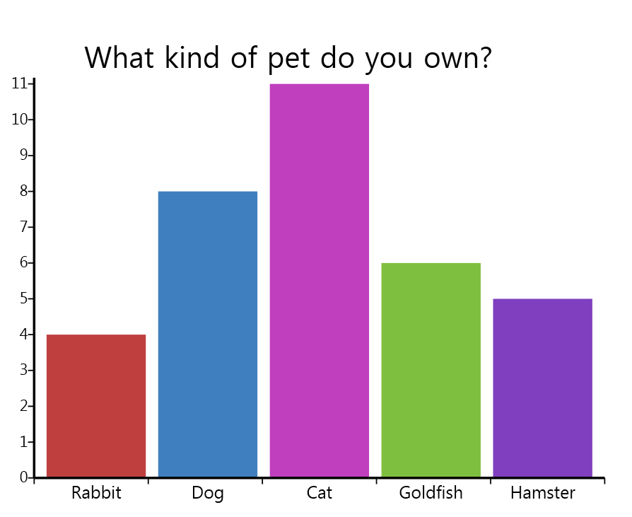
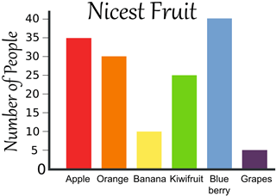
Activate Prior Knowledge
List the similarities between the graphs on your whiteboard.
Favourite Type of Fruit
Number of students
Number of People
Type of pet
Type of fruit

Slide 5
Concept Development
CFU 1
Which of the following are quantitative observations? There are 9 flowers on the plant The flowers are red There are green leaves on the plant The flowers on the plant have 5 petals
Scientists often show quantitative observations using graphs. For discrete data, they use column graphs.
Discrete data is data that can be counted or sorted into categories.
For example, the number of people in a class or the number of cows in a field (you wouldn’t count half a person or half a cow).
CFU 2
In your own words, what is discrete data?
CFU 3
Which of the following is discrete data? Be ready to give a reason why. The plant is 35.7cm tall There are 9 flowers on the plant
Vocabulary
dis·crete da·ta (noun) data that can be counted or sorted into categories

Slide 6
Concept Development
Scientists often show quantitative observations using graphs. For discrete data, they use column graphs.
Steps for drawing a column graph:
Draw the horizontal and vertical axes
Label the horizontal axis with the independent variable
Label the vertical axis with the dependent variable
Draw each column with a ruler
Write an appropriate title
Vocabulary
dis·crete da·ta (noun) data that can be counted or sorted into categories

Slide 7
Skill Development/Guided Practice
CFU 1
What is the independent variable?
Aim: To find out if different types of roses produce different amounts of flowers.
CFU 2
What is the dependent variable?
The data collected in the experiment is shown in the table below.
CFU 3
Is this data quantitative or qualitative?
Type of Rose | Number of Flowers
Red | 5
White | 7
Pink | 4
Vocabulary
dis·crete da·ta (noun) data that can be counted or sorted into categories

Slide 8
Skill Development/Guided Practice
Type of Rose | Number of Flowers
Red | 5
White | 7
Pink | 4
Aim: To find out if different types of roses produce different amounts of flowers.
Step 1: Draw the horizontal axis two squares from the bottom and the vertical axis two squares from the left edge.
Always use a ruler for this step.
Vocabulary
dis·crete da·ta (noun) data that can be counted or sorted into categories

Slide 9
Skill Development/Guided Practice
Type of Rose | Number of Flowers
Red | 5
White | 7
Pink | 4
Aim: To find out if different types of roses produce different amounts of flowers.
Step 2: Label the horizontal axis with the independent variable.
Mark out the columns and leave a space between each one.
Label each column.
Vocabulary
dis·crete da·ta (noun) data that can be counted or sorted into categories
red
white
pink
Type of Rose

Slide 10
8
Skill Development/Guided Practice
7
Aim: To find out if different types of roses produce different amounts of flowers.
6
Step 3: Label the vertical axis with the dependent variable.
Mark every second square with a small dash and, starting with 0 at the bottom, number the dashes.
The last number must be higher than the biggest number in the table.
5
4
Number of Flowers
3
2
Type of Rose | Number of Flowers
Red | 5
White | 7
Pink | 4
1
0
red
white
pink
Type of Rose

Slide 11
8
Skill Development/Guided Practice
7
Aim: To find out if different types of roses produce different amounts of flowers.
6
Step 4: Draw in each column using a ruler.
5
4
Number of Flowers
3
2
Type of Rose | Number of Flowers
Red | 5
White | 7
Pink | 4
1
0
red
white
pink
Type of Rose

Slide 12
8
Number of Flowers on Different Types of Roses
Skill Development/Guided Practice
7
Aim: To find out if different types of roses produce different amounts of flowers.
6
Step 5: Add an appropriate title that states what the graph is about.
5
4
Number of Flowers
3
2
Type of Rose | Number of Flowers
Red | 5
White | 7
Pink | 4
1
0
red
white
pink
Type of Rose

Slide 13
Relevance
Drawing graphs is an important and helpful way to represent data from experiments.
You will need to be able to draw an appropriate graph for your experiments.
Vocabulary
dis·crete da·ta (noun) data that can be counted or sorted into categories

Slide 14
Skill Closure
Look at the graph below. Identify the mistakes in the graph and how they should be fixed.

Slide 15
Independent Practice
On graph paper, draw a column graph of the data below.
Steps for drawing a column graph:
Draw the horizontal and vertical axes.
Label the horizontal axis with the independent variable.
Label the vertical axis with the dependent variable.
Draw each column with a ruler.
Write an appropriate title.
Favourite Colour | Number of Students
Green | 5
Yellow | 2
Blue | 8
Red | 5
Purple | 3

